Slide 1
Electron Dosimetry
Shibu J Anamalayil, MS

Slide 2
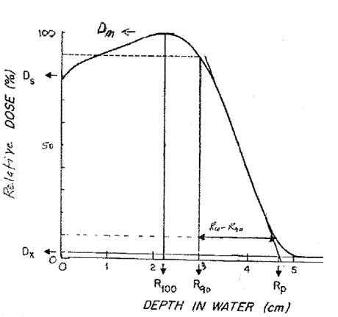
% Depth Dose
The picture from the book : The physics of radiation therapy: Third edition by Faiz M Khan

Slide 3
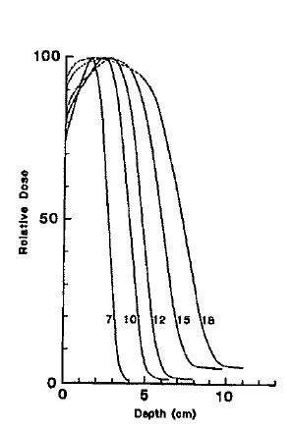
Depth Dose energy Dependence (6-20MeV)
As energy increases
Surface dose (Ds) increases (70%-90%)
Therapeutic depth( R₉₀) increases.
Practical range (Rp) increases.
Bremsstrahlung dose (Dx) increases.
Picture from AAPM therapy review course John Antalock PhD

Slide 4
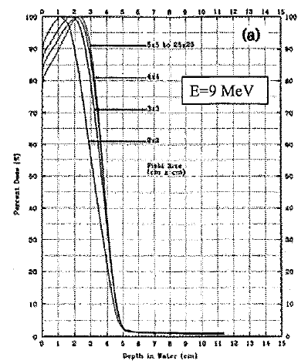
% Depth Dose Filed size dependence
As field size decreases
Therapeutic depth( R90) decreases.
Surface dose(Ds) increases.
Practical range remains constant.
Increase of Ds more significant at lower energies.
Decrease in R90 is less significant at lower energies.
Picture from AAPM therapy review course John Antalock PhD

Slide 5
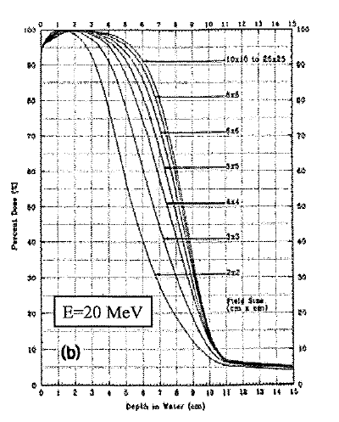
% Depth Dose Filed size dependence
As field size increases
Therapeutic depth( R90) decreases.
Surface dose(Ds) increases.
Practical range remains constant.
Increase in Ds less significant at higher energies.
Decrease in R90 more significant at higher energies
As field size decreases
Therapeutic depth( R90) decreases.
Surface dose(Ds) increases.
Practical range remains constant.
Increase in Ds almost insignificant at higher energies.
Decrease in R90 more significant at higher energies.
Picture from AAPM therapy review course John Antalock PhD

Slide 6
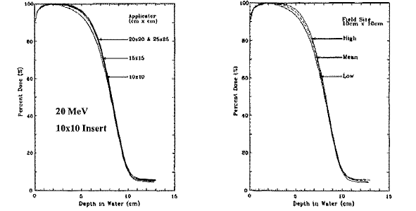
% Depth dose Applicator dependence:
Dependence of %DD on applicator is minimal and is ignored. (Shiu et al., 1994)
Picture from AAPM therapy review course John Antalock PhD

Slide 7
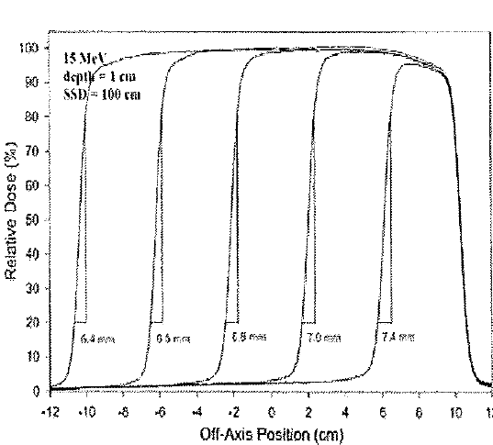
Penumbra-field size dependence
Penumbra is the edge of the beam where there is not side scatter equilibrium
Penumbra width is a measure of penumbra shape. P₈₀₋₂₀=distance from 80% to 20%
Penumbra width remains constant as field size increases if there is side scatter equilibrium on central axis
Picture from AAPM therapy review course John Antalock PhD

Slide 8
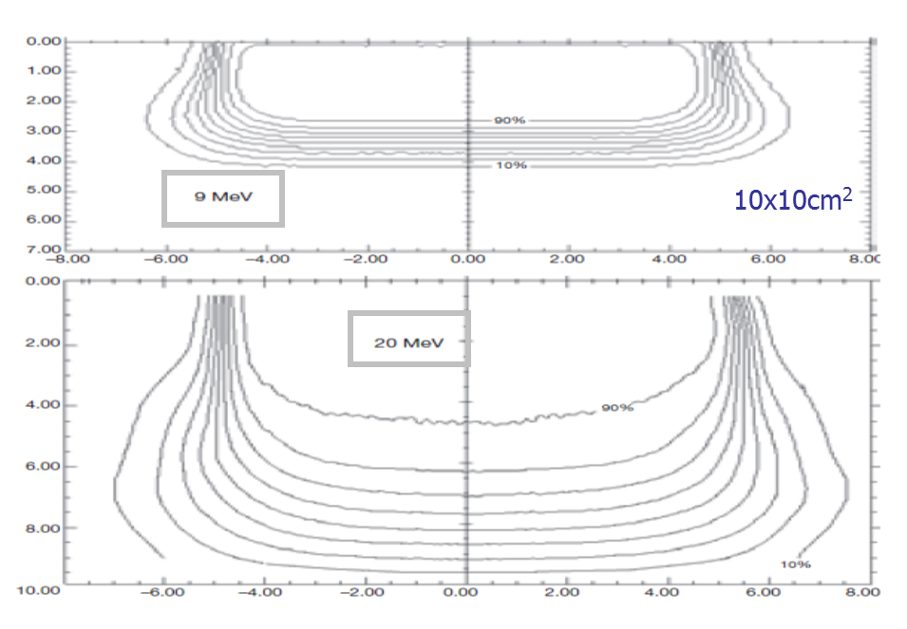
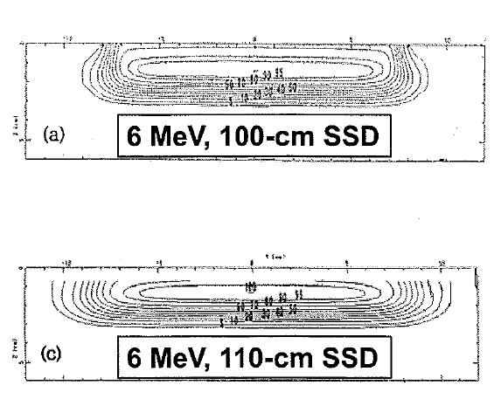
Penumbra – Energy and SSD dependence
Penumbra width at surface increases in proportion to air gap
Penumbra width at surface is sharper at higher energies
Picture from AAPM therapy review course John Antalock PhD

Slide 9
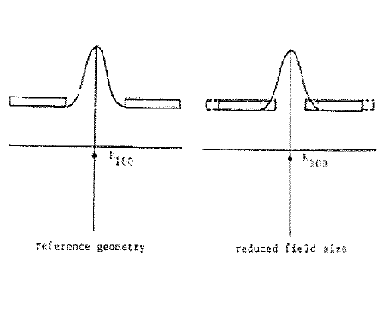
Output Field size dependence
Once the field size reaches below the practical range , the output increasingly begins to decrease as electrons previously reaching R100 are removed from the beam by collimation.
Loss of side scatter equilibrium
Electrons scattering off the edge of the collimator increases with increasing field size due to increased perimeter of aperture
Picture from AAPM therapy review course John Antalock PhD

Slide 10
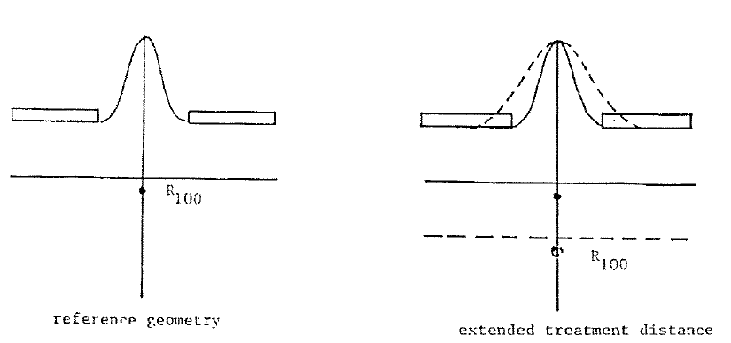
Output SSD dependence
Output decreases with increasing SSD ( ie, increasing air gap) due to 2 effects.
Inverse square effect from virtual source
Loss of side scatter equilibrium
Picture from AAPM therapy review course John Antalock PhD

Slide 11
Influence of patient Anatomy on Electron dose Distribution
Patient Surface
Oblique incidence
Irregular surface
Internal Heterogeneities
Bone
Air
Lung

Slide 12
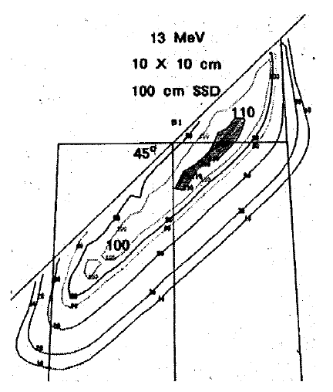
Effect of Oblique incidence on Dose distribution:
Penumbra
Decreases for surfaces closer to source
Increases for surface farther from the source
Picture from AAPM therapy review course John Antalock PhD

Slide 13
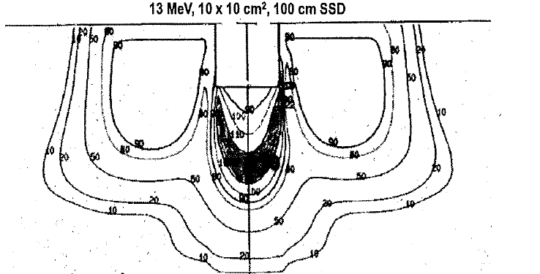
Effect of irregular surface on Electron dose distribution
Increased dose in shadow of depression
Decreased dose around its periphery
Picture from AAPM therapy review course John Antalock PhD

Slide 14
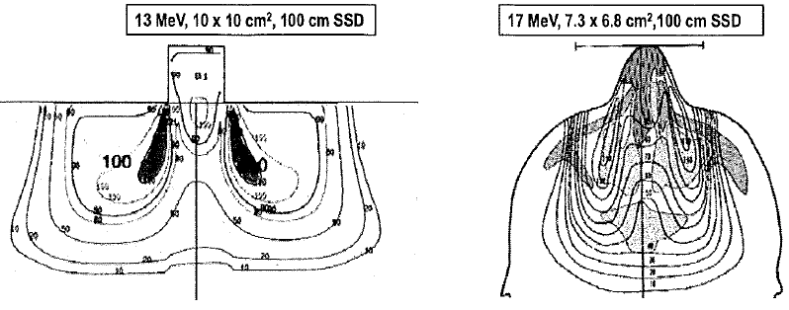
Effect of irregular surface on Electron dose distribution
Decreased dose in shadow of protrusion
Increased dose around its periphery
Picture from AAPM therapy review course John Antalock PhD

Slide 15
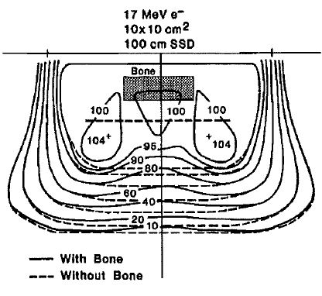
Effects of Bone on Electron dose distribution:
Therapeutic dose contours( 80%-90%) shift toward surface
Hot spots lateral to bone and cold spots under bone.
Picture from AAPM therapy review course John Antalock PhD

Slide 16
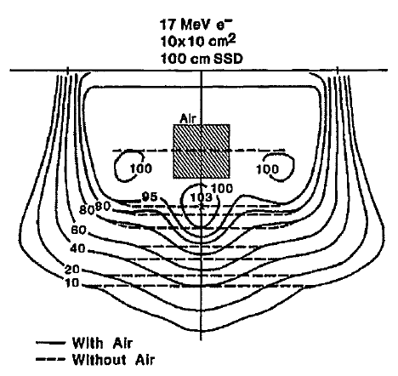
Effects of Air on Electron dose distribution:
Dose falloff regions penetrates deeper
Hot/Cold spots can become significant ( as much as 20%)
Picture from AAPM therapy review course John Antalock PhD

Slide 17
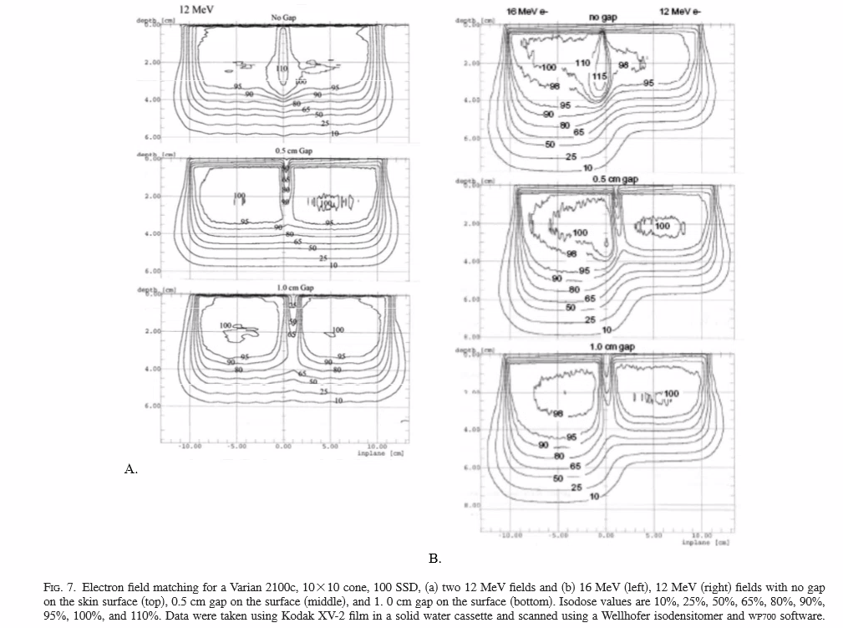
Electron-Electron Field Matching
Picture from AAPM therapy review course John Antalock PhD

Slide 18
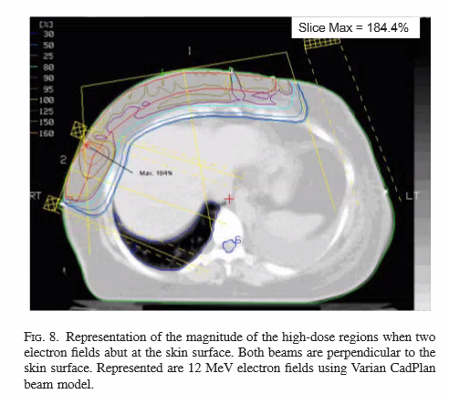
Electron Field matching contd..
Electron – Electron field matching needs special considerations.
Matching can cause unintended hot spots.
Matching of different beam angles causes even more hotspots.
Matching at the skin and feathering is the normal clinical approach.
Matching at skin
Picture from AAPM therapy review course John Antalock PhD

Slide 19
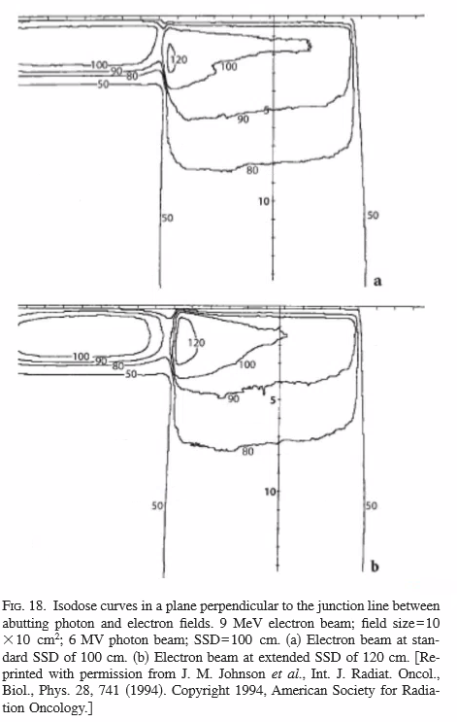
Electron-Photon Field Matching:
Matching can cause unintended hot spots.
Hotspots are on the photon field side due to bulging of isodose lines.
Hotspots increases when extended SSD used.
Matching at the skin and feathering is the normal clinical approach.
IMN field matching for breast treatment planning is the most common.
Picture from AAPM therapy review course John Antalock PhD

Slide 20
Sharp edge irregularities-Lead
Electron – Electron field matching needs special considerations.
Matching can cause unintended hot spots.
Matching of different beam angles causes even more hotspots.
Matching at the skin and feathering is the normal clinical approach.
Matching at skin
Slides taken from Dimitris/Pohlit W Manegold etal…

Slide 21
Internal Shielding for electron treatments :
Treatment of lips, Buccal mucosa, eyelid lesions.
Lead shielding is used.
The dose enhancement due to back scatter at the tissue-lead interface can be in the range 30%-70% for 1MeV-20MeV with higher value for the lower energy.
To dissipate backscatter, a suitable thickness of low atomic number absorber such as bolus or wax can be placed between the lead tissue interface.

Slide 22
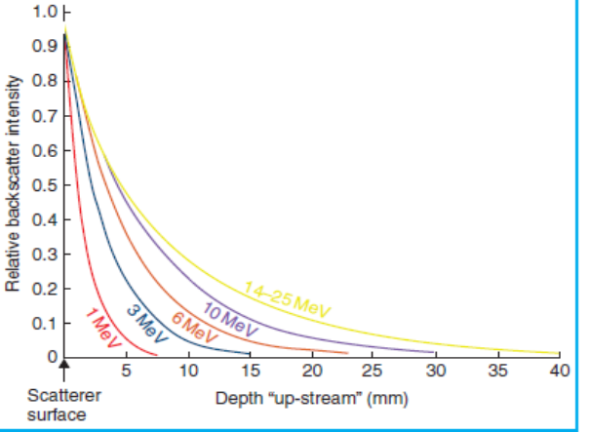
How would you manage a 2cm thick lesion on the mucosa on the cheek?
What energy?
d_{90%}=E/4cm→9MeV
Need to protect the oral structures
Compute electron energy beyond tumor
2cm x 2MeV/cm=4MeV lost, thus 5MeV electrons make it beyond the lesion
Need to calculate Pb thickness to stop 5MeV electrons
t_{Pb}=5/2 + 1=3.5mm
Pb will create backscatter increase of dose to mucosa
EBF=1.56, 56% backscatter
Need to use bolus (polystyrene or wax) to reduce backscatter to less than 10%
From Fig. 5MeV electron backscatter needs ~4mm bolus.

Slide 23
Clinical Electron – Rules
Beam energy should be selected to ensure that
R90 > maximum depth of PTV
Rp < depth of critical structure.
Practical range = Energy/2
R90~ Energy / 3.3
Energy loss in tissue is 2MeV/cm
Most probable energy in tissueEd= E0(1- d/Rp)
Lead thickness to block= Energy/2 in mm.
If Cerrebond : Use 1.2*Pb thickness.

Slide 24
Thank you
References :
The physics of radiation therapy: Third edition by Faiz M Khan PhD.
AAPM Therapy Physics review course by John A Antalock. PhD.
Pictures and slides from Dimitris Polit etal…review course by John A Antalock. PhD.
Recommendation of Clinical electron dosimetry: Supplement to the recommendation of TG25 by Gerbi etal..

